Slide 1
DelDOT Program Forecast
Utility Summit 02/22/2022

Slide 2
Excellence in Transportation Every Trip. Every Mode. Every Dollar. Everyone.
Every Trip
We strive to make every trip taken in Delaware safe, reliable and convenient for people and commerce.
Every Mode
We provide safe choices for travelers in Delaware to access roads, rails, buses, airways, waterways, bike trails, and walking paths.
Every Dollar
We seek the best value for every dollar spent for the benefit of all.
Everyone
We engage and communicate with our customers and employees openly and respectfully as we deliver our services.

Slide 3
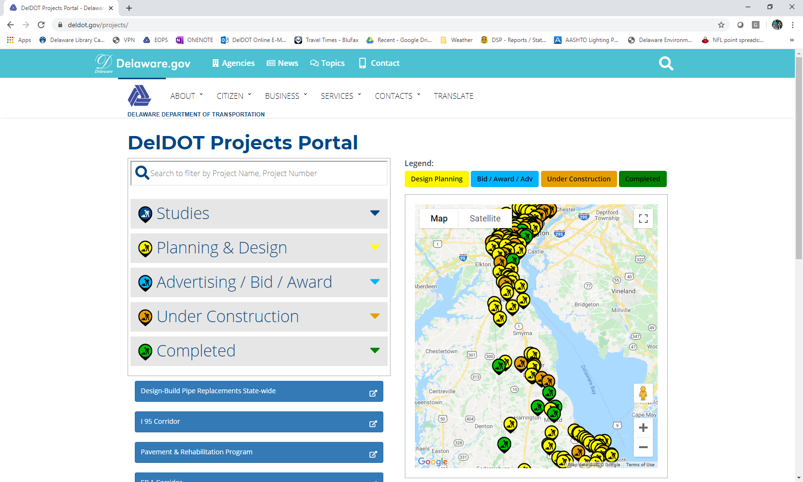
Project Updates
Corridor Approach
www.deldot.gov/projects
Notes:
This presentation hits many projects on the main corridors, but is not comprehensive. It does not include bridge or pave & rehab projects, which are obviously sizable and have significant traffic impacts.

Slide 4
New Castle County

Slide 5
I-95 Rehabilitation Project
Restorethecorridor.com
Extends from I-495 / I-95 split to US 202 (Concord Pike)
CM/GC – Kiewit
Elimination of S. Jackson Street ramp to I-95 SB
New 2nd Street on-ramp to I-95 SB
Advanced projects
Break-out projects
Mainline construction scheduled to start in March 2021
Long-term lane closures on I-95 started in February 2021
Phase 1 completed December 2021
Phase 2 is currently active (SB lanes closed, all traffic in contra-flow in NB lanes)
2 years or less of reduced lane capacity on I-95
Automated speed enforcement activated 1/17/2022
Notes:
19 bridges, 3 miles of pavement, 11 ramps
$280M not including Wilmington paving or other advanced projects like Sweep Removal

Slide 6
I-95 Rehabilitation Project Regional Traffic
Impact Area
(Original)

Slide 7
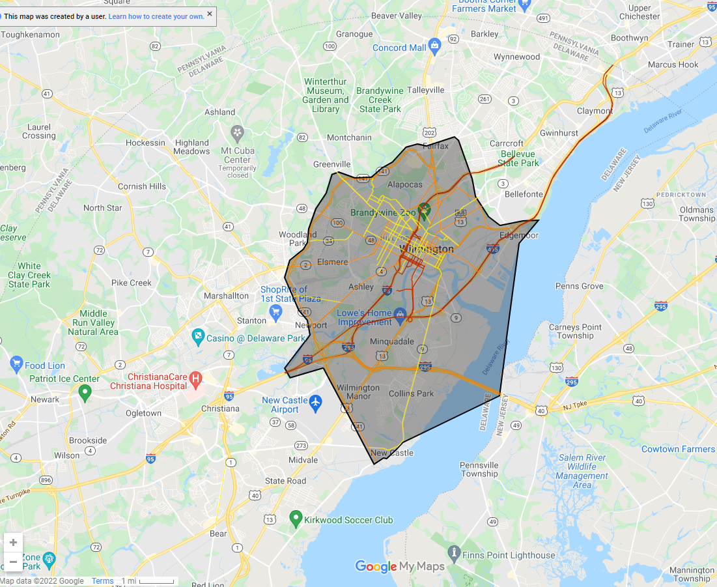
I-95 Rehabilitation Project Regional Traffic
Impact Area
(Current)

Slide 8
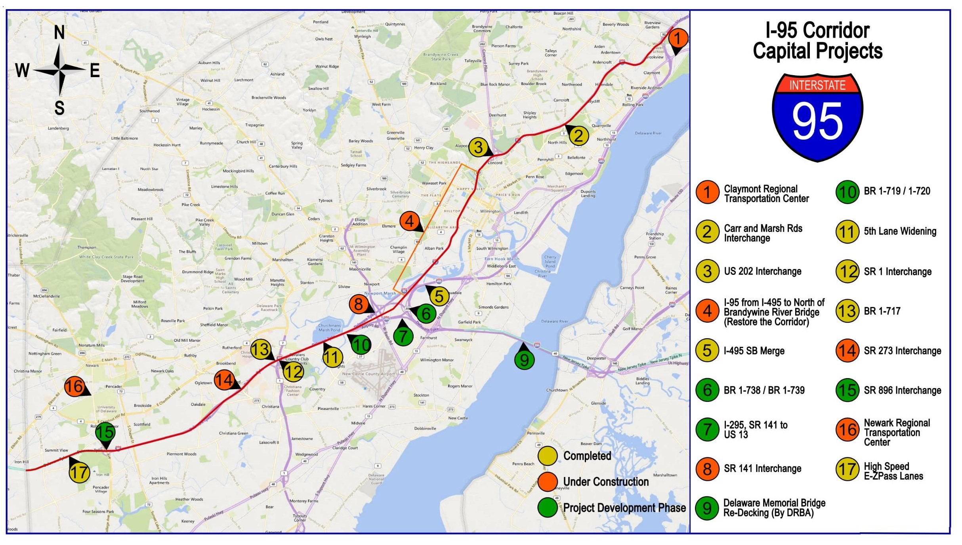
Notes:
SR 141, I-95 Interchange to Jay Drive – Complete Spring 2022. Significant work on 95 and 95 ramps done before Viaduct.
I-95 Rehabilitation from I-495 to North of the Brandywine River Bridge– mainline lane closures starting 2/2021; 2 years of lane closures or less
Pre-requisite Projects: Walnut Street Sweep, Double Left on 12th street to Northeast Blvd, I-95 Carr Rd & Marsh Rd, CRB & approaches – goal to be open before I-95 Rehab starts
CM/GC Project – Awarded to Kiewit.
I-95 Carr Road & Marsh Rd – Project Awarded to Greggo & Ferrara in October 2018; Substantially complete fall 2020
I-95 / SR 273 – start Spring 2021, end Summer 2022
I-295, 141 to 13 – design starts in 2021, C – 2024-2026
Christina River Bridge: Substantially complete
Newark Train Station:
Parking Lot & Access Road – Complete
Station Building - Complete
Track A and Platform – Anticipated completion 2023
I-95, SR 896 Interchange – Preliminary design phase is underway. INFRA Grant awarded. Begin C 2022 – Completed 2025. CM/GC
I-295, 141 to 13. Engineering to start in FY22.
Various bridges to rehab on 95, after 95 reconstruction
Claymont RTC – Design-Build, design and construction ongoing, to be complete in 2023

Slide 9
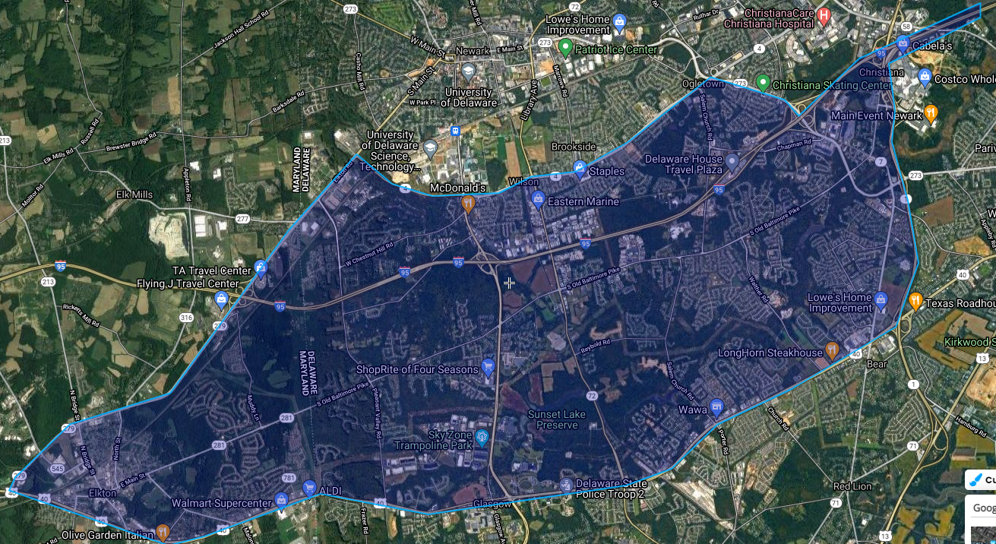
I-95 / SR 896 Project Regional Traffic
Impact Area

Slide 10
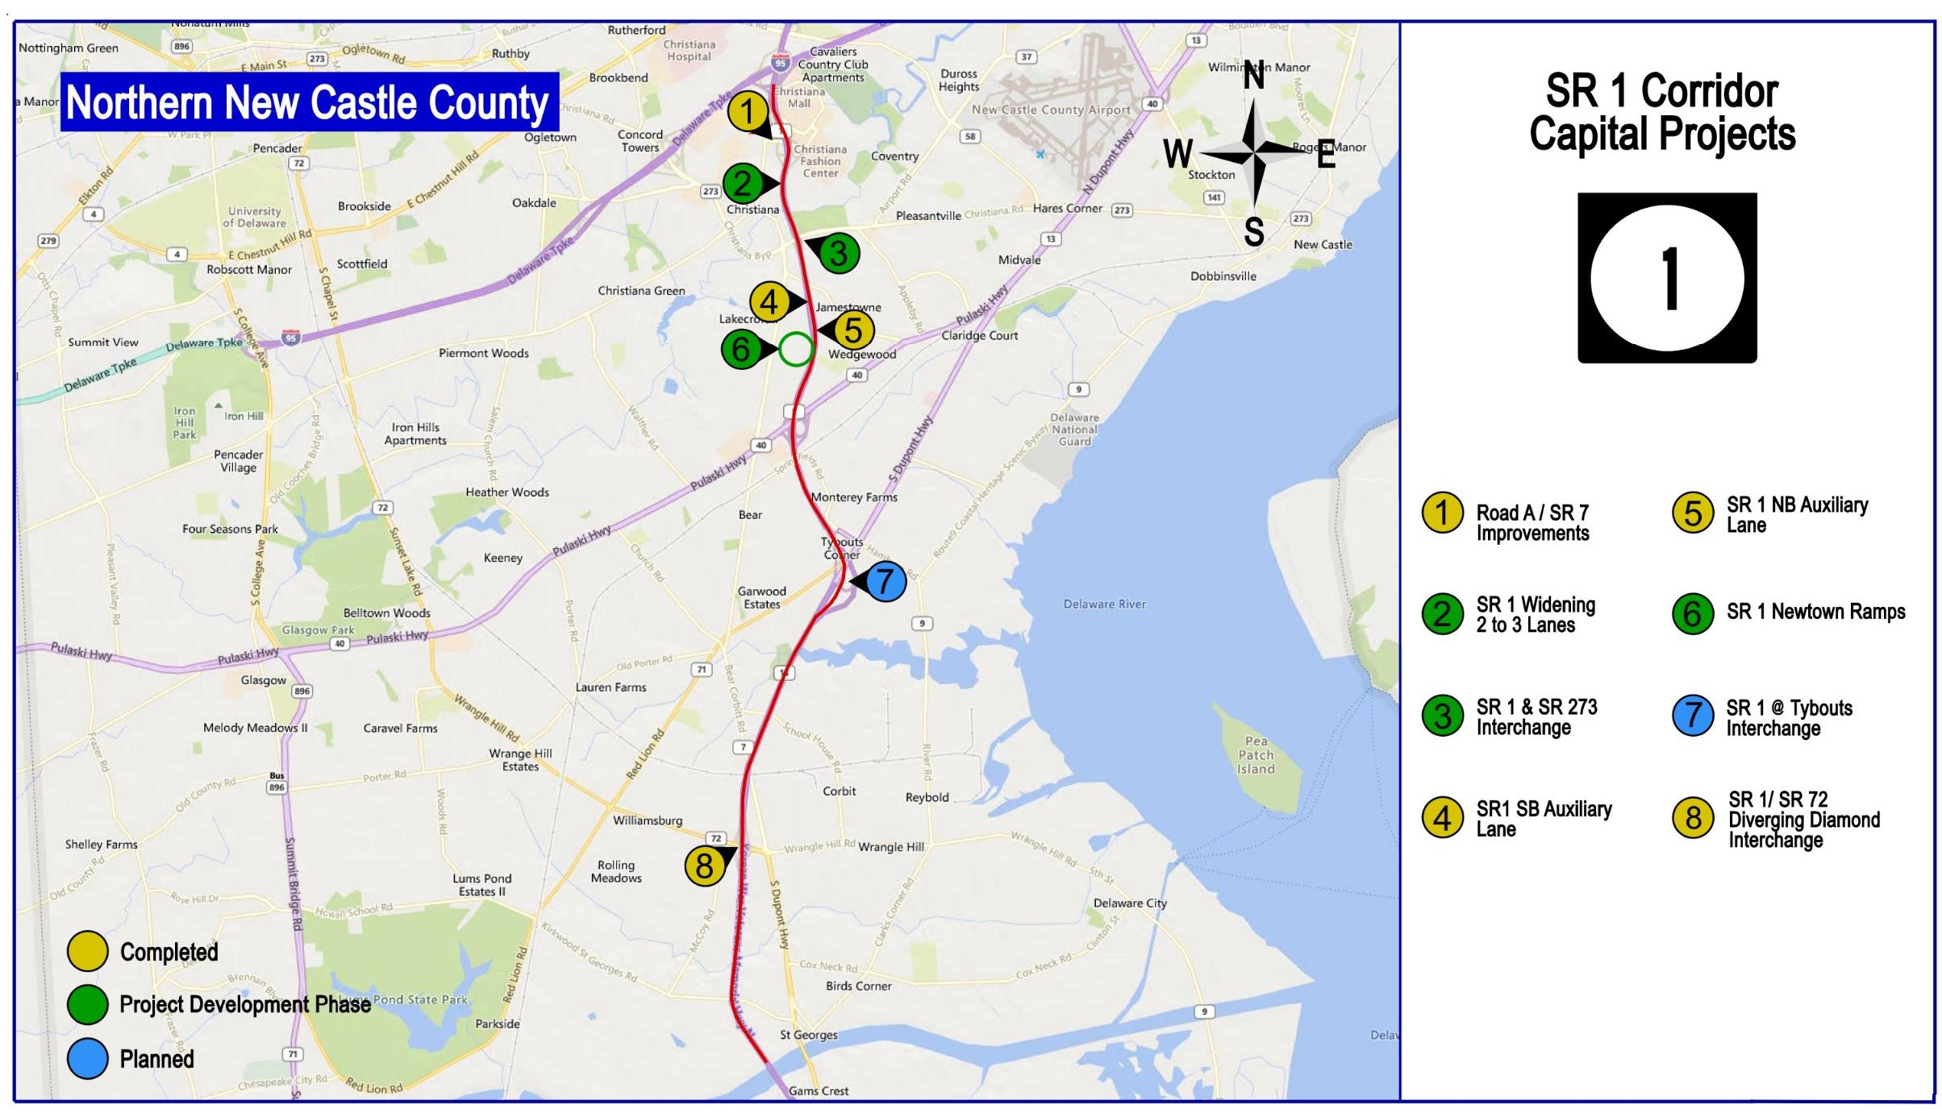
Notes:
SR 1 NB Auxiliary lane was a big success. It reduced morning congestion by 40%. = low cost high value project
SR 72 DDI – Complete
SR 1 Widening – Workshop held on Nov. 19; A project of this magnitude takes many years of planning, environmental approvals, public outreach, design, and ultimately construction; Beginning with Newtown ramps…
SR 1 SB Aux Lane – Substantially complete.
SR 1 – Tybouts to Roth – future, not yet programmed
Road A – new bridge opened prior to Thanksgiving 2020. Construction to be complete in spring 2021.

Slide 11
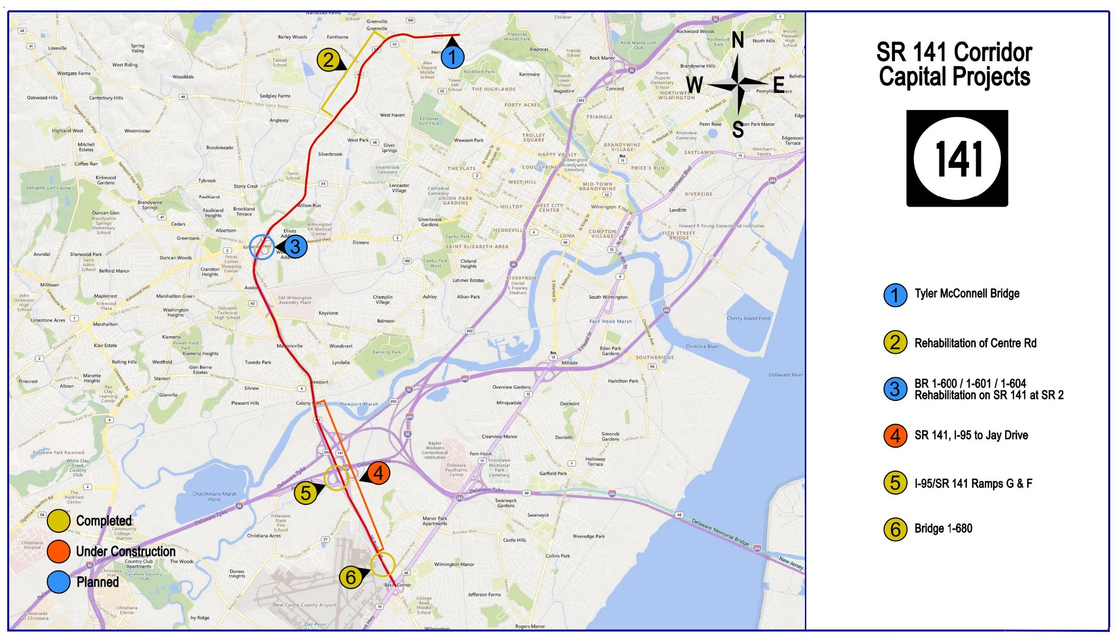
Notes:
SR 141 Ramps G & F – complete.
SR 141, I-95 Interchange to Jay Drive – Construction start Summer 2019; Complete Spring 2022
Rehab of Centre Road – Reopened in November; Construction completed Spring 2019
Tyler McConell – in CTP but no schedule for PE to start yet
SR 141/SR 2 bridge rehab – on hold until after 95 Reconstruction
US 13 Peds:
Lighting (Llangolen to 495) in construction, complete in Spring 2021
Pave & Rehab / Sidewalk / ADA / Bus Lane (Rogers to Boulden) – complete Spring 2021
Paving & Sidewalk/ADA (Llangolen to Boulden) – in design, C-2022-2023
Median Barrier, 40 to 495, in design, C-pending

Slide 12
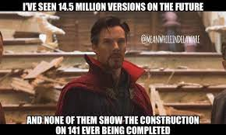

Slide 13
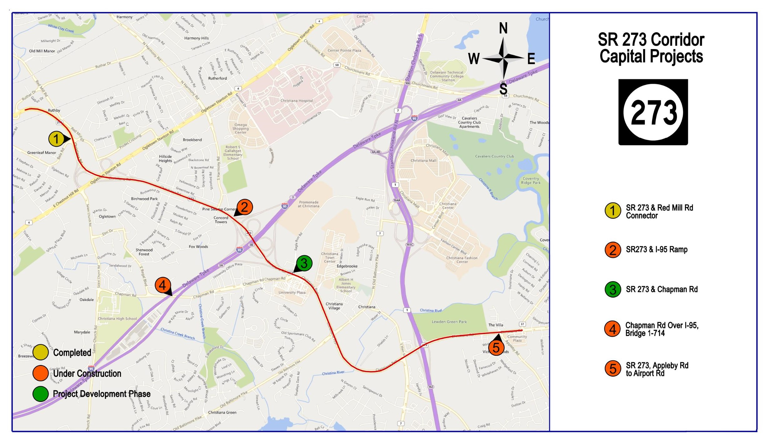
Notes:
SR 273, Appleby Rd to Airport Road – under construction. Expected completion spring 2021.
SR 273/Red Mill – C Spring 2019. Complete fall 2019.
SR 273/I-95 Ramp – Field work and preliminary design underway; C Winter 2020/2021 through to summer 2022
SR 273/Chapman – Design is underway. Construction planned Fall 2021 through Spring/Summer 2022 (subject to change . . .)
Chapman Bridge – complete winter 2021/2022

Slide 14
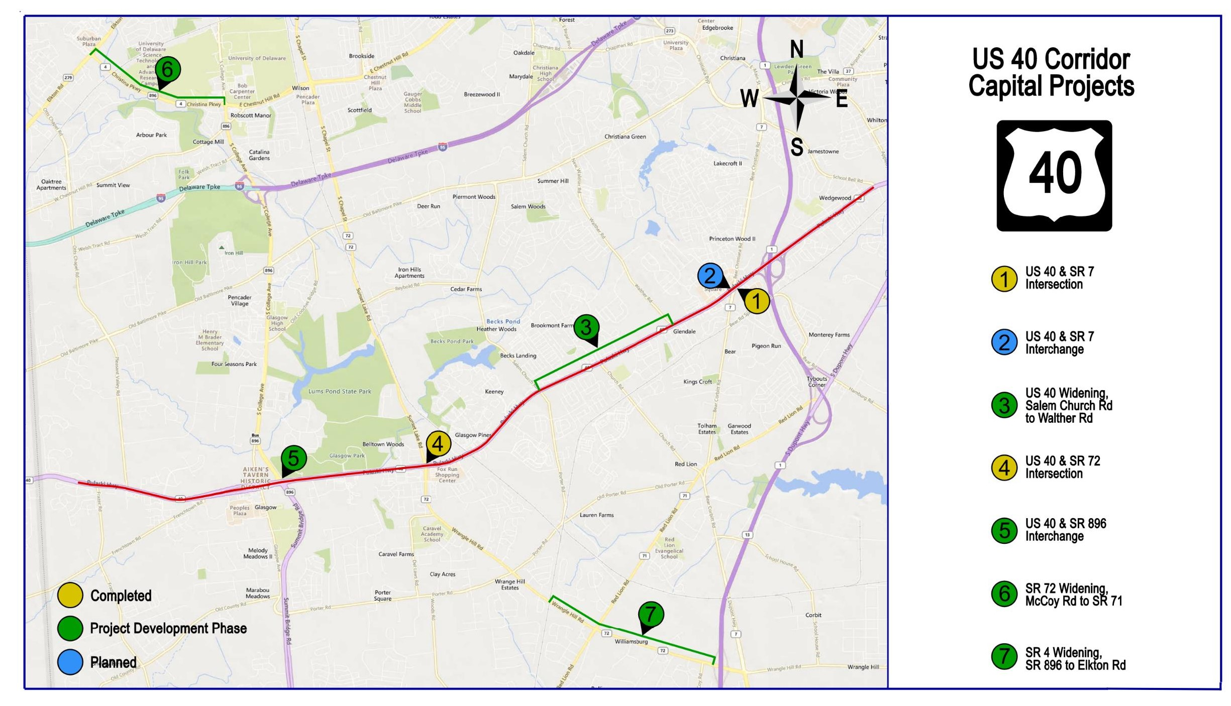
Notes:
US 40/SR 896 – In design. Construction scheduled for 2024-2026
US 40/SR 72 Intersection Improvements – Construction is underway – scheduled to be complete in early 2021.
SR 72 Widening – advanced utilities started in 2019. C – Spring 2022 - 2024
US 40 Widening, Salem Church Road to Walther Road – adds an additional lane; design underway. Workshop in 2020. C – 2023-2025
US 40 / SR 7 – peds, lane modifications – substantially complete.
US 40 / SR 7 Interchange - scheduled to start PE in FY 23. No C in CTP yet.
NOT SHOWN: SR 2/Red Mill Road – in design, C-2022-2024
SR 4 – in design, C-2025-2027
NOT SHOWN: Elkton Road – C-2020-2022
NOT SHOWN: SR 896/Bethel Church, PE – FY23, C – not funded yet

Slide 15
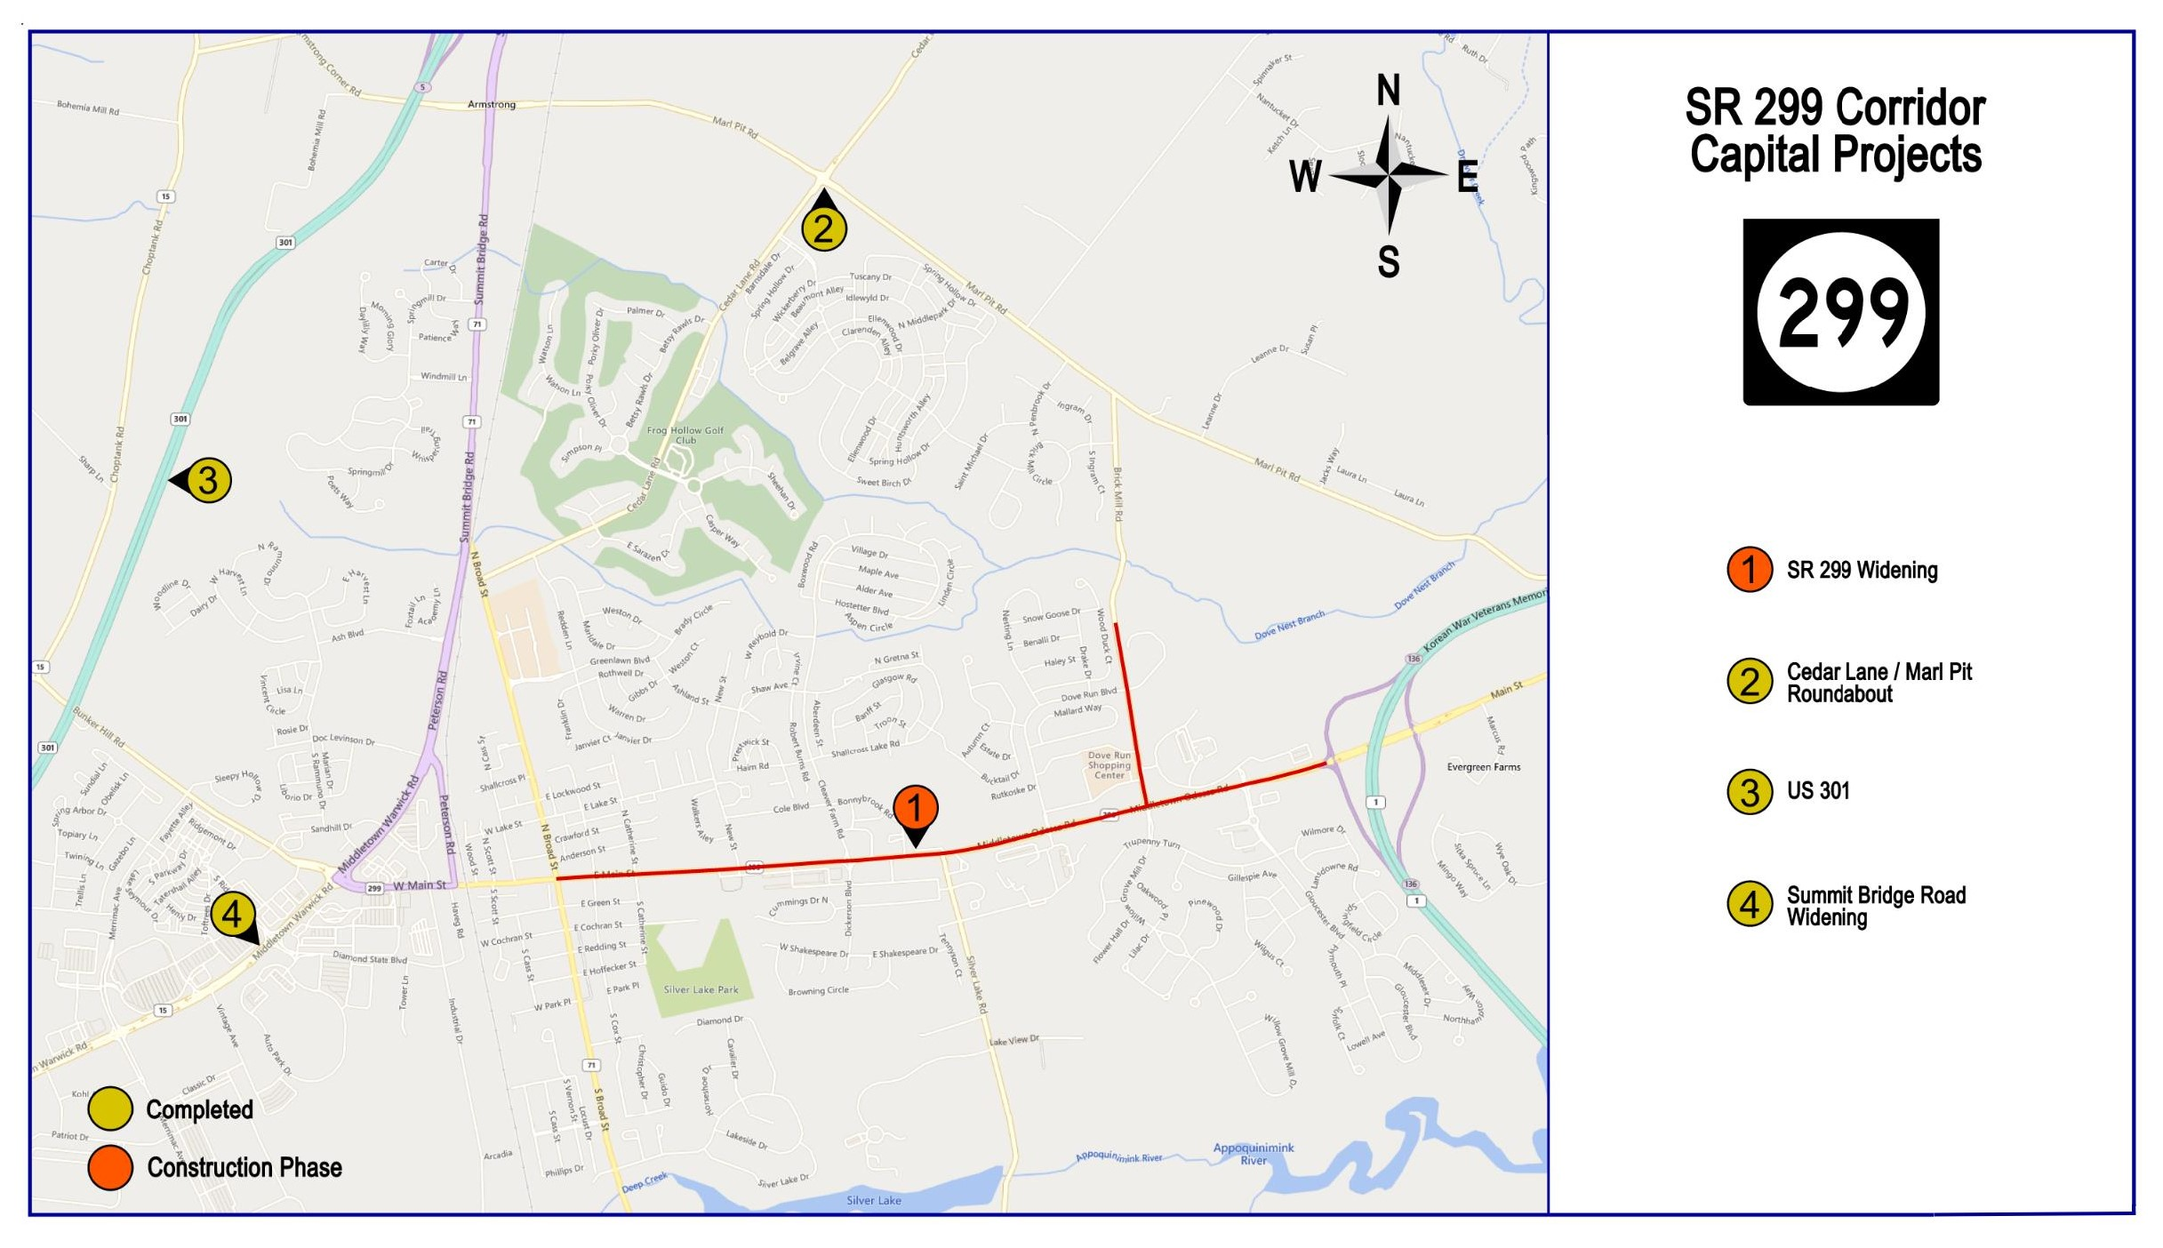
Notes:
301 – opened to traffic in Jan. 2019
Cedar Lane/Marl Pit roundabout – opened to traffic in 2020
SR 299: As of late Jan. 2021, we now have ROE on all parcels, advanced utilities can proceed (HOT). Construction to start Aug. 2021, and end in fall 2023.
NOT SHOWN – Lorewood Grove Road – in design, C-2026-2027. Scope being reassessed related to TID and newly proposed developments.
NOT SHOWN – Boyds Corner Road – in design, C- not in CTP at this time.

Slide 16
Kent County

Slide 17
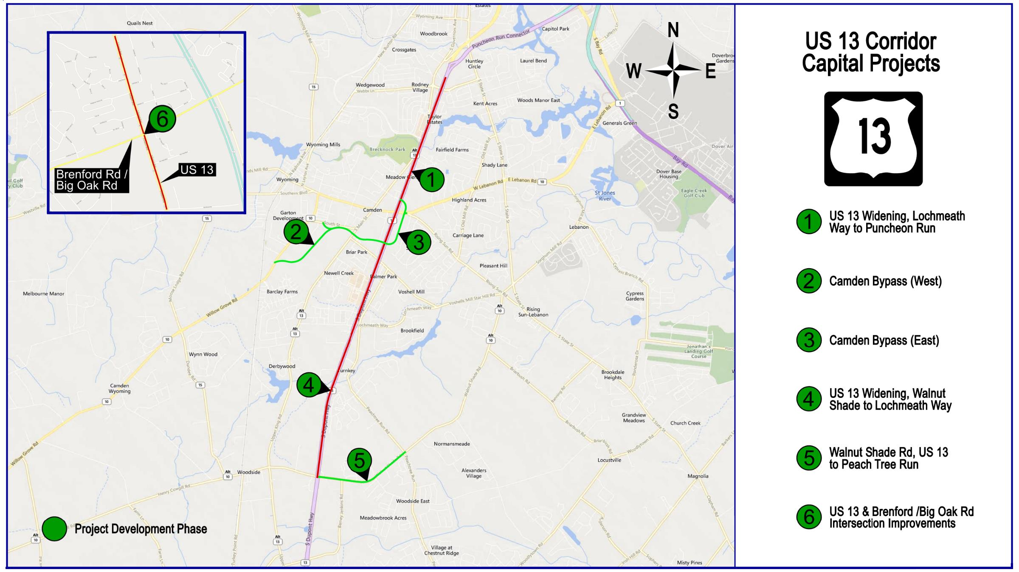
Notes:
US 13 Widening (Lochmeath to Puncheon Run) – Semi-final Design is underway; Construction 2022-2025.
US 13 Widening (Walnut Shade Rd to Lochmeath) – Preliminary Design is underway; Construction 2023-2026.
Camden Bypass – preferred alternative selected. In design. Construction scheduled for 2023-2025.
Walnut Shade – roundabout at Peach Tree and multi-modal path, 13 to Peach Tree. In design. Construction 2023-2024.

Slide 18
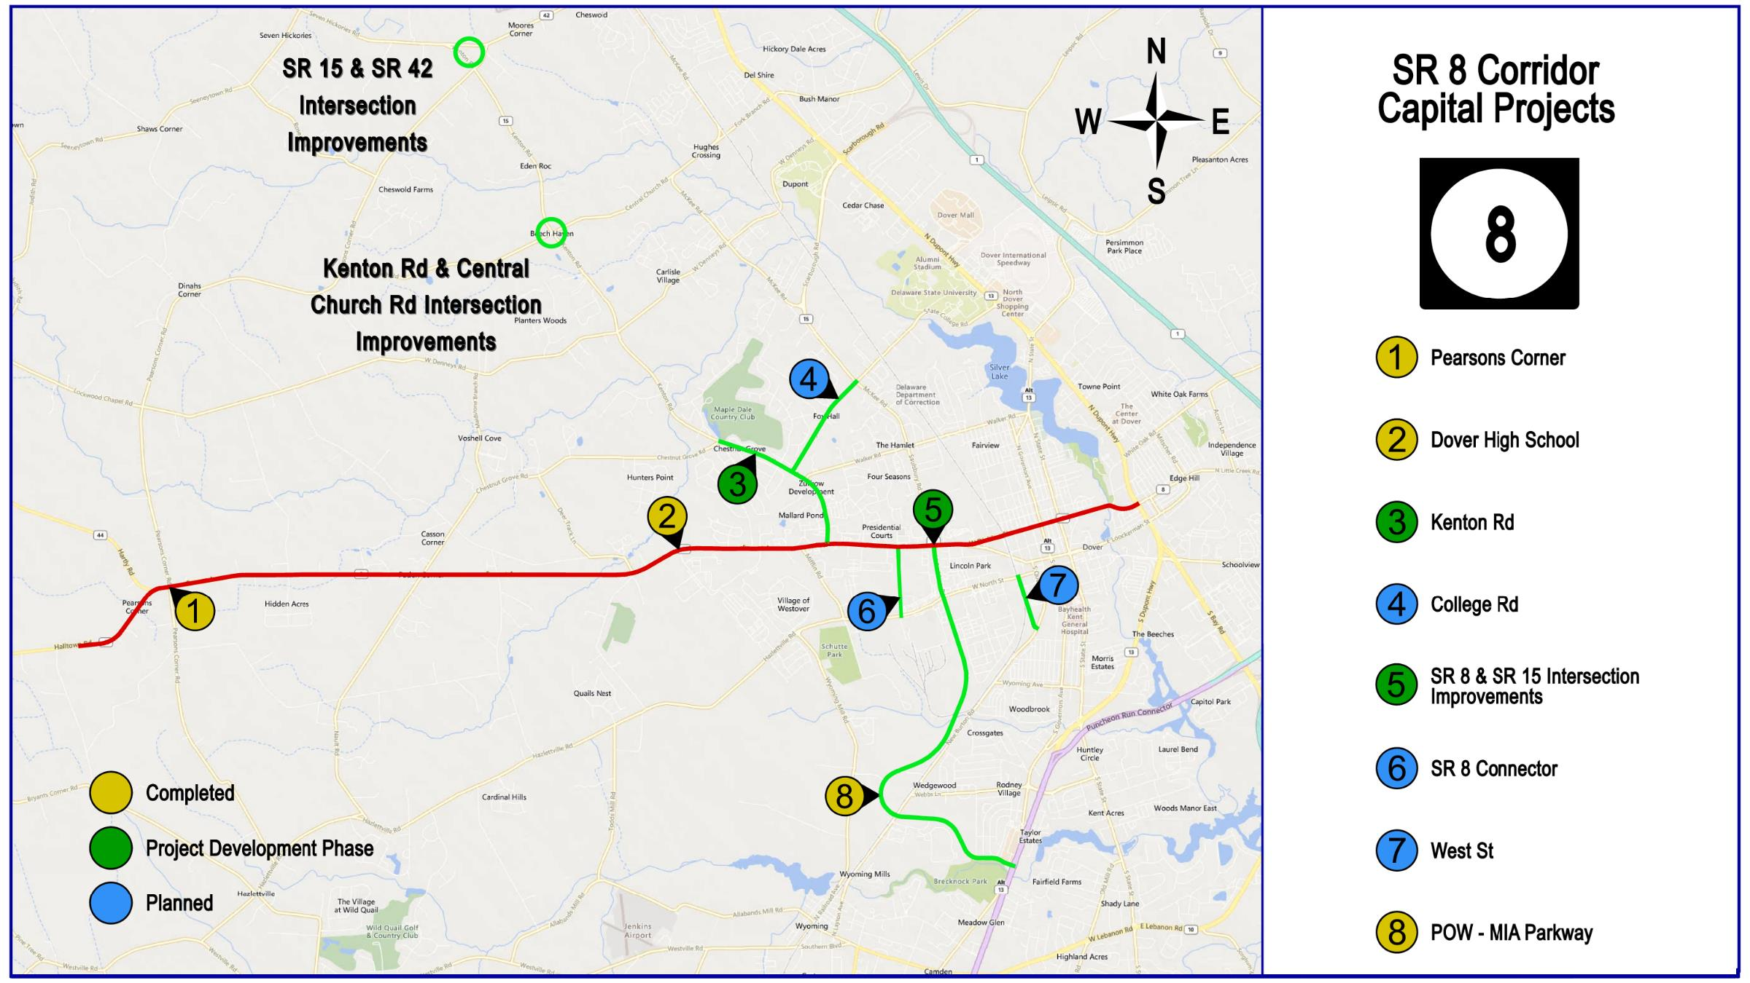
Notes:
POW-MIA Parkway – completed in 2017
SR 8/SR 15 – Safety project; design ongoing. Construction 2021-2022. Utility statement issued Feb. 2021, advanced utilities ongoing.
SR 8 Connector – not scheduled yet. Doing traffic study now. C – 2025-2026 (for now)
Kenton Road in design. Construction could potentially begin as early as 2022, but isn’t funded until at least FY28.

Slide 19
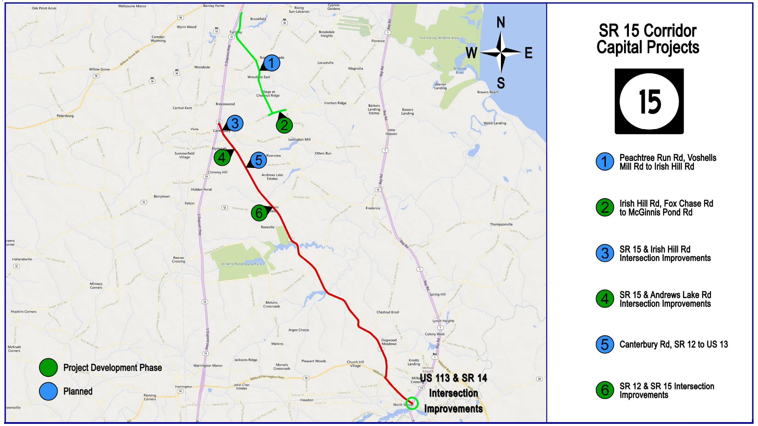

Slide 20
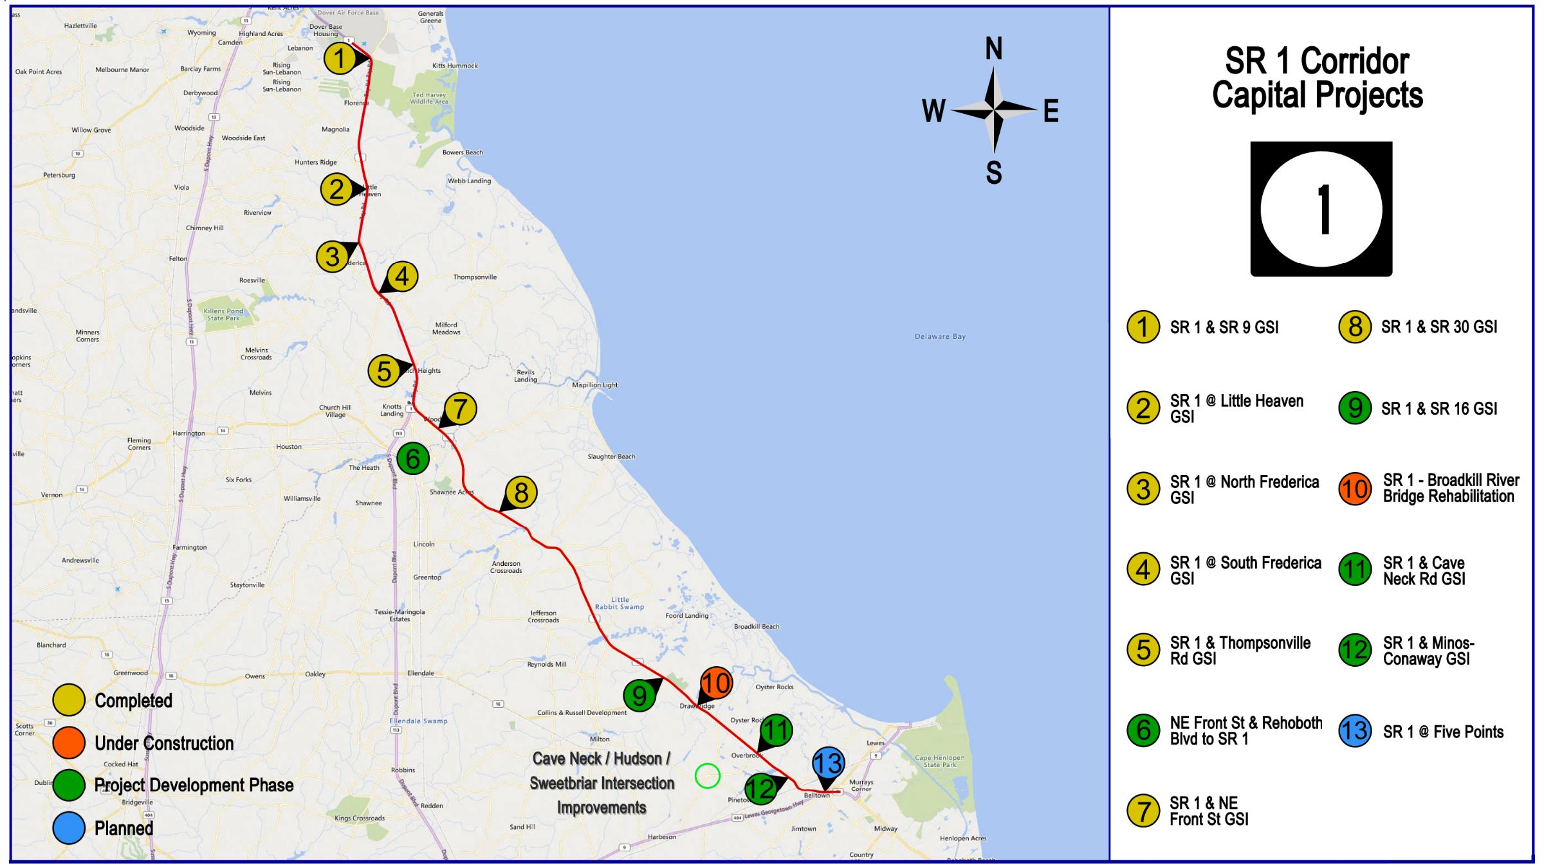
Notes:
NE Front St, Reho Blvd to SR 1 – This project proposes the addition of shoulders, bike lanes and sidewalks and/or multi-use paths. PE – 2021-2023; C – 2025-2026.
NE/NW Streetscape project; design is underway; Construction anticipated to start summer 2021 and complete Fall 2021
SR 1, SR 16 –RW acquisition nearly complete; Adv. for bids in May 2021; Construction - late Summer 2021 to 2024. Utilities a priority once R/W clears (HOT).
SR 1, Minos Conaway – RW acquisition start Winter 2020/2021; Construction – 2023-2025
SR 1, Cave Neck – Preliminary Design underway; RW acquisition start Fall 2021; Construction – 2025-2026
SR 1, Five Points – Phase 1 Planning study done; Phase 2 underway. Need area improvements completed to determine new traffic patterns and to accommodate detours for the grade separation (unfunded).

Slide 21
Sussex County

Slide 22
Notes:
113/14 intersection – in design, C – 2023-2024
US 113 at SR 16 GSI – Conceptual design is underway. A public workshop will be held in the winter of 2019/2020 to present alternatives. Construction is currently funded 2027-2029.
US 113 at SR 18/404 GSI – Preliminary Design is underway; We are moving forward with Alternative B, which includes loop ramps on the northeast and southwest quadrants of the intersection. We will be holding meetings with property owners in the winter of 2019/2020. A second public workshop was held 2/19/2020. Construction is anticipated for 2024 - 2026.
US 113 at US 9 GSI – in CTP but currently unfunded
North Millsboro Bypass – design is underway. Field survey is complete. ROW work 2021-2023; Construction is anticipated for 2023 - 2026. Schedule may change with split of project and CM/GC.
US 113 Widening – PE in FY23, C not in CTP yet.

Slide 23
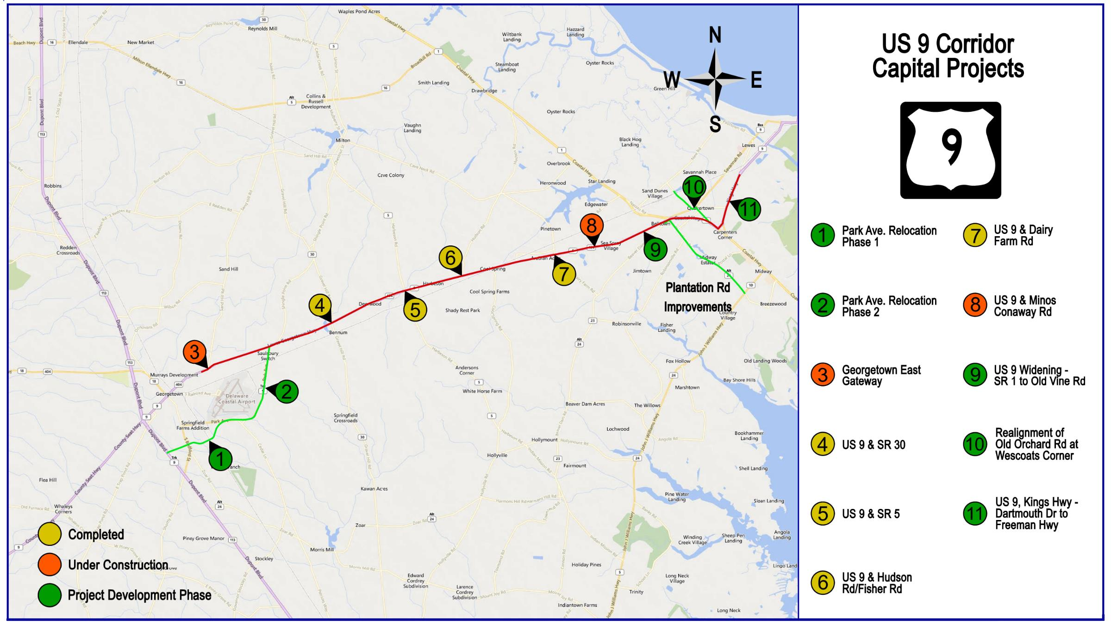
Notes:
Georgetown East Gateway (US 9/Sandhill/Airport Rd) – C – summer 2020- spring 2022
US 9 @ Park Ave (Phase 2) – Part of Park Avenue Relocation Phase 2; Preliminary design is underway. Construction is anticipated for 2023 - 2025.
Park Ave (Phase 1, not shown on map) – C-Fall 2021-2023
US 9 & SR 5 Intersection Improvements – Construction substantially complete in August 2019
US 9 & Minos Conaway - PE in FY24; C – FY27
US 9 Widening (Ward Ave to Old Vine Rd) – PE starts in FY22; C – starts in FY27
US 9 (Kings Hwy), Dartmouth Drive to Freeman Hwy – PE starts in FY22; C- FY26-FY27
Old Orchard / Wescoats – in design, R/W plans nearly done. 2021 – start acquiring R/W; 2022 – start advanced utilities; C-2023-2025

Slide 24
Notes:
We have been strategizing a comprehensive approach to the construction coordination for these projects using a Master Scheduling approach. The timing of when each goes to construction may change from what is listed below pending the outcome of the master scheduling study. A liaison will be assigned to this corridor during construction to handle constituent concerns, just like we did on SR 26 and US 301.
Public Info Mtg – 2/25/2021
SR 24 Mulberry Knoll to SR 1 – Construction is underway; Completion 2022
SR 24, Love Creek to Mulberry Knoll – RW acquisition underway; C – 2022-2023
SR 24, Camp Arrowhead and Angola/Robinsonville –RW acquisition underway; Construction 2021-2022
SR 24@ Long Neck Road (SR 5 & SR 23) – Design complete – Advertise for bids in Dec. 2020; Construction Spring 2021 – Fall 2022
SR 24 @ Mount Joy and Bay Farm – Finalizing utility relocation plans; Construction Summer 2021-2023
North Millsboro Bypass – RW acquisition is underway; Construction start 2023; Breaking into two contracts, one will be CM/GC
Plantation Phase 1 – in design, C-2022-2023
Plantation Phase 2 – on hold pending updated TID traffic analysis and recommendations

Slide 25
Thank You!
Mark Luszcz
Delaware Department of Transportation
Division of Transportation Solutions
Deputy Director (Design)
Mark.Luszcz@Delaware.gov
302-760-2356

